Slide 1


Slide 2
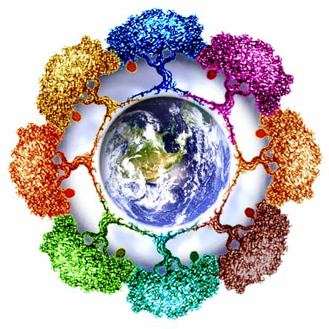
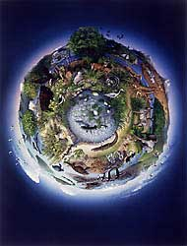
Everything YOU need to know about ECOLOGY
For the AP Biology AP test

Slide 3
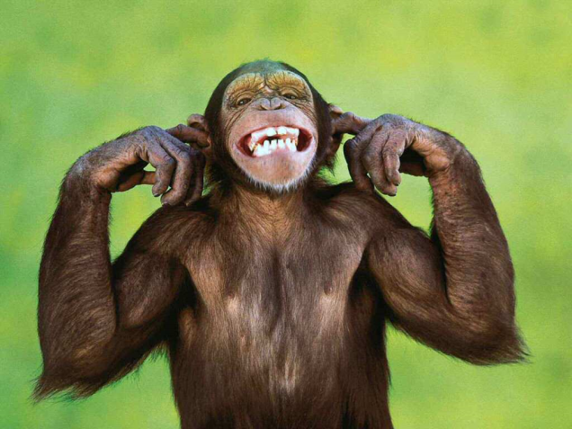
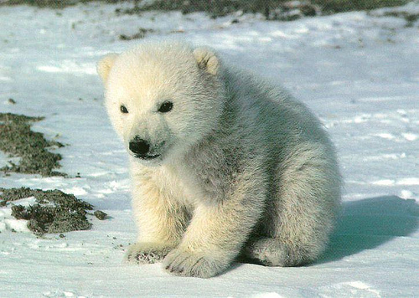
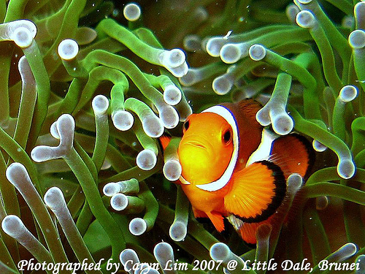
Ecology-Basic Definitions
Ecology is the scientific study of animals, their environments, and how they react with them.

Slide 4
Biosphere - the entire part of the earth where living things exist.
Ecosystem – the interaction of living and nonliving things
Community- a group of populations in the same area
Population- a group of individuals of the same species that interbreed.

Slide 5
Biospheres are Divided into Biomes
The Major Biomes are:
Tundra
Taiga
Temperate Deciduous Forest
Grasslands
Deserts
Tropical Rain Forests

Slide 6
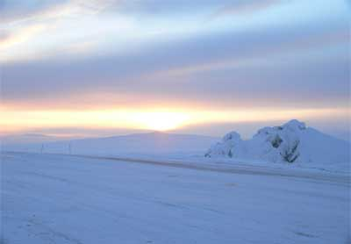
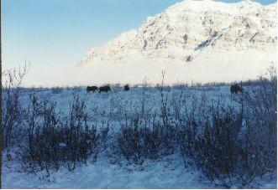
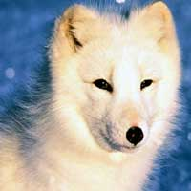
Tundra
Northern Regions
Few trees, mostly grasses and wildflowers
A layer of permanently frozen soil and has a short growing season
Animals include Arctic animals

Slide 7
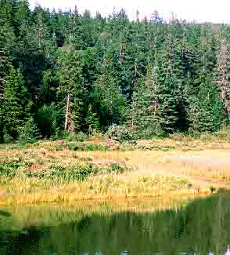
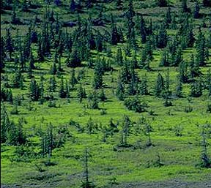
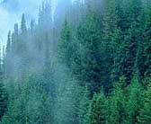
Taiga
Northern Forests Region
Evergreens and wind blown conifers
Very long, cold winters
Caribou, wolves, bears, moose, bears, rabbits

Slide 8
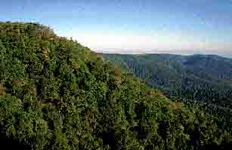
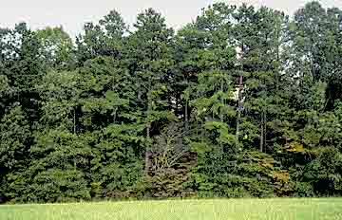
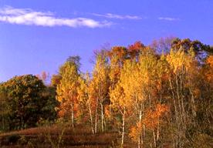
Temperate Deciduous Forests
NE, Mid E US, Western Europe
Deciduous trees that drop their leaves in winter
Medium precipitation, warm summers, cold winters
Deer, wolves, bears, small mammals, birds

Slide 9
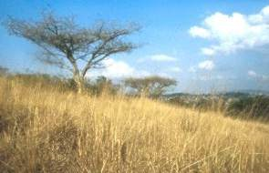
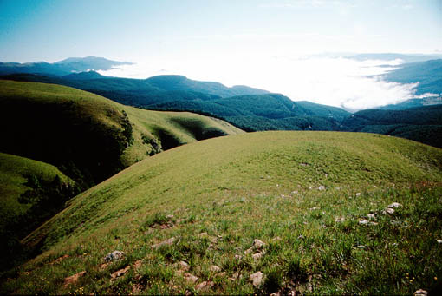
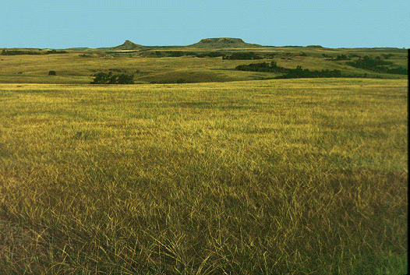
Grasslands
American Midwest, Eurasia, Africa, So. America
Grasses
Hot summers, cold winters, unpredictable rainfall
Prairie dogs, bison, foxes, ferrets, grouse, snakes, and lizards

Slide 10
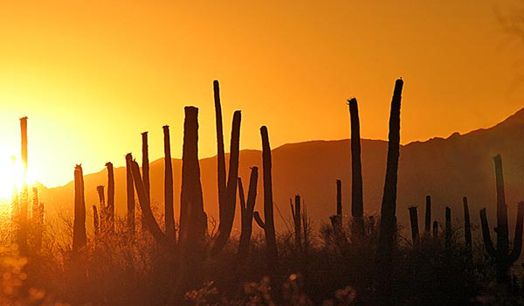
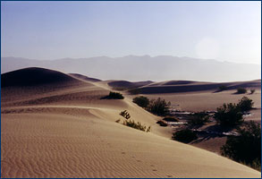
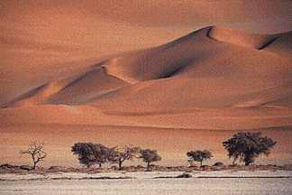
Deserts
Western US
Sparse plant life, cacti, drought resistant plants
Low rainfall, extreme temperature shifts between night/day
Reptiles, jackrabbits, owls

Slide 11
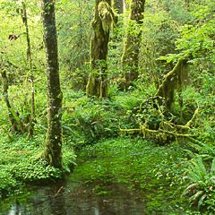
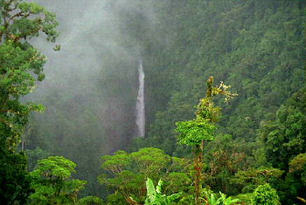
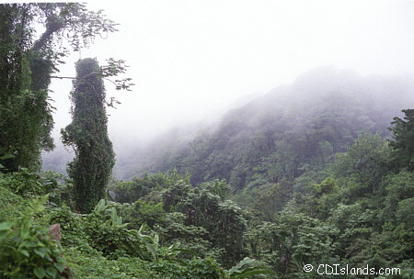
Tropical Rain Forests
South America
High plant diversity, high biomass
High rainfalls and temperatures, impoverished soil
Sloths, snakes, monkeys, birds, leopards, and insects

Slide 12
Communities
All organisms within a community are either producers, consumers, or decomposers
Each organisms has its own niche (function in a community)
Connections between different organisms can be seen in food chains

Slide 13
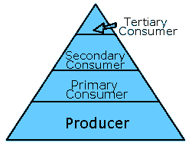
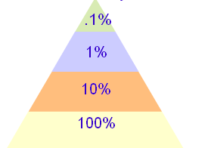
Ecological Pyramid
The higher the organisms, the less biomass and energy, and fewer numbers.
Each higher level gains only 10% of the energy from the level before it

Slide 14
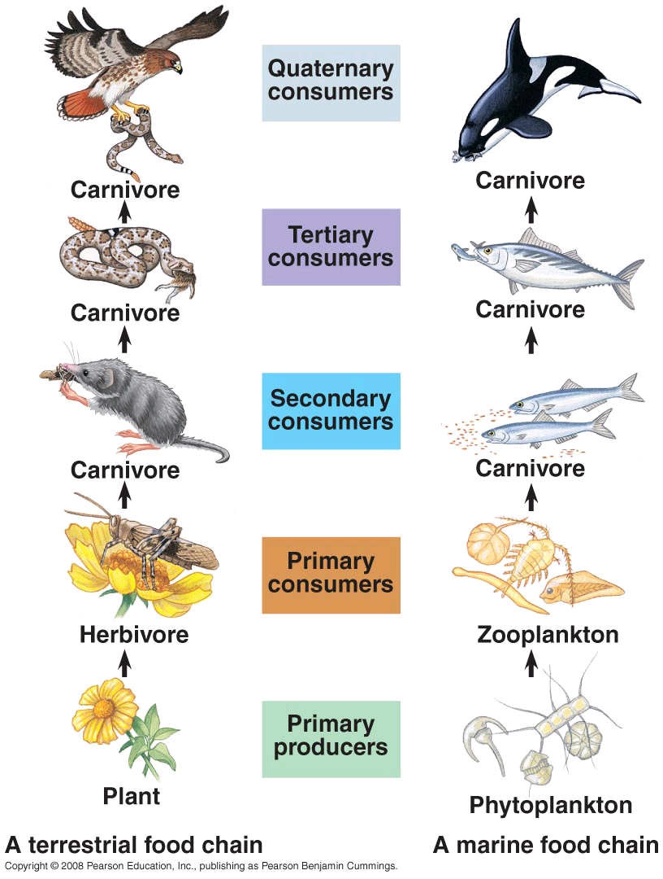
Here are some examples of animals that fit into an ecological pyramid.

Slide 15
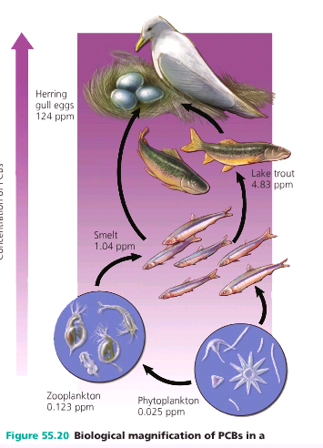
Biological Magnification
Toxins in an ecosystem are more concentrated and more dangerous for animals further up in the pyramid

Slide 16
Population Ecology- Basic Definitions
The growth Rate of a population can be represented by the equation: rate=(births-deaths)/population size
Carrying Capacity- the max individuals of the species that can be support in a habitat

Slide 17
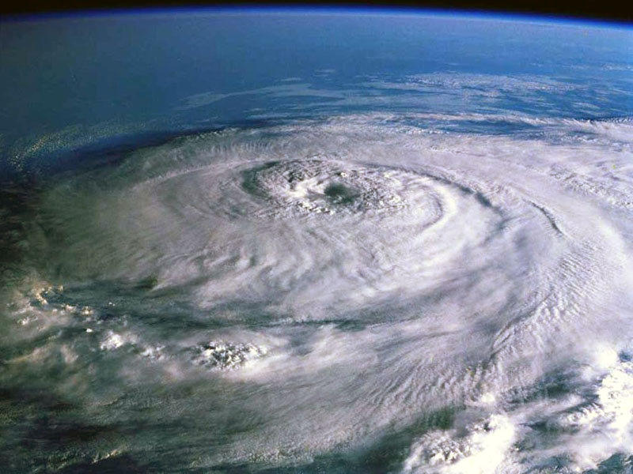
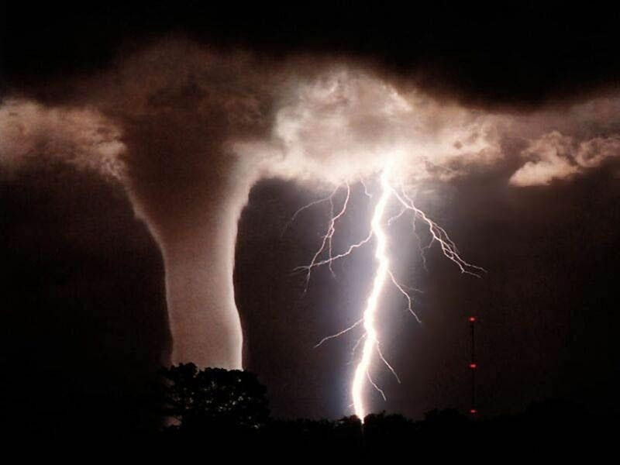
Population Density
Density –independent factors affect the population regardless of the population density. EX. Extreme weather climates.

Slide 18
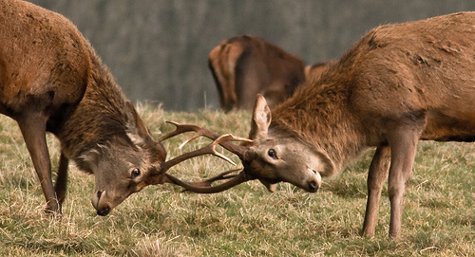
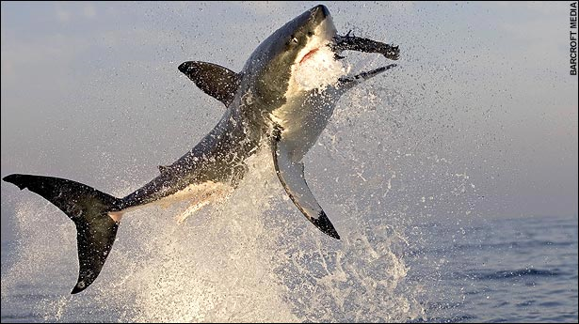
Density-dependant factors are those with effects that depend on population density such as competition, predation, and resource depletion.

Slide 19
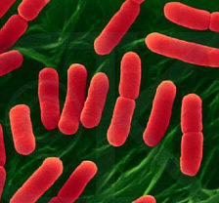
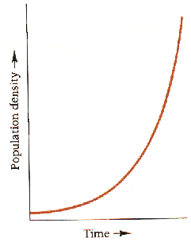
Exponential Growth
Exponential growth occurs when a population is in an ideal environment and there is room, resources, and no death.
Bacteria have an exponential growth rate

Slide 20
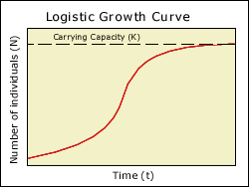
Logistic Growth
The population becomes restricted in size because of limited resources.

Slide 21
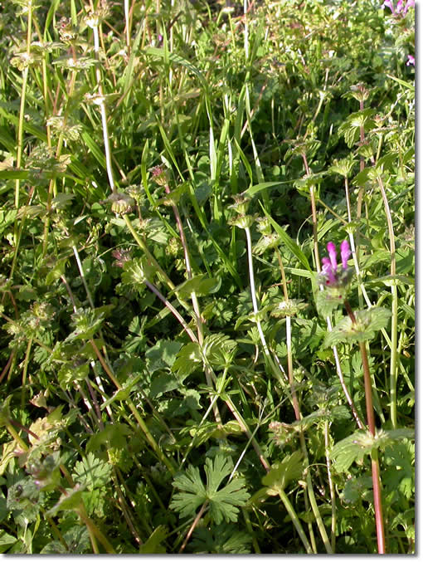
R-strategists & K-strategists
R-strategists produce a lot of offspring to ensure survival and to secure their environment before competitors arrive.
(ex) weeds

Slide 22
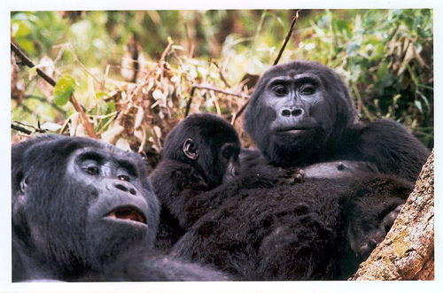

K-strategists are better suited for stable environments and try to avoid reaching the carrying capacity of a population. They usually produce relatively few offspring with a good chance of survival.

Slide 23
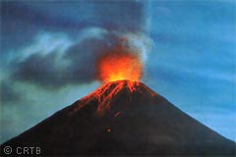
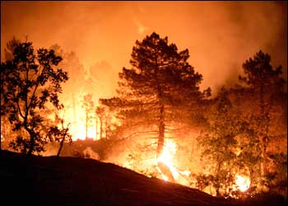
Ecological Succession
Primary succession – no previous organisms have existed
Secondary succession- when a new community develops where another has been destroyed of disrupted
Primary Succession
Secondary Succession

Slide 24
Inter-specific Interactions
-=suffers +=benefits 0=neither wins or loses
Competition (-|-)
Predation (+|-)
Mutualism (+|+)
Commensalism (+|0)

Slide 25
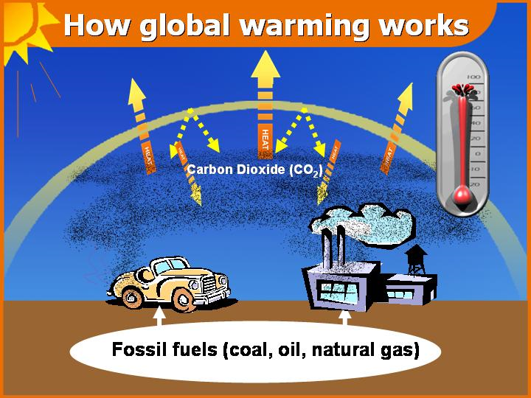
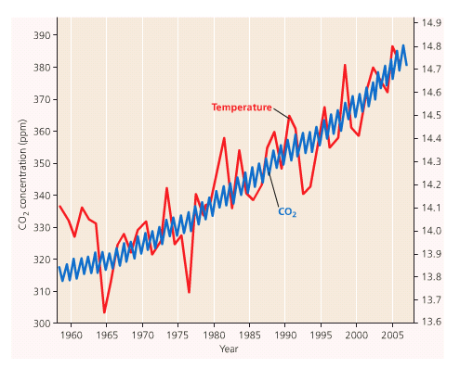
Human Impact on the Environment
Increased green house gases result more heat getting trapped in our atmosphere causing global warming

Slide 26
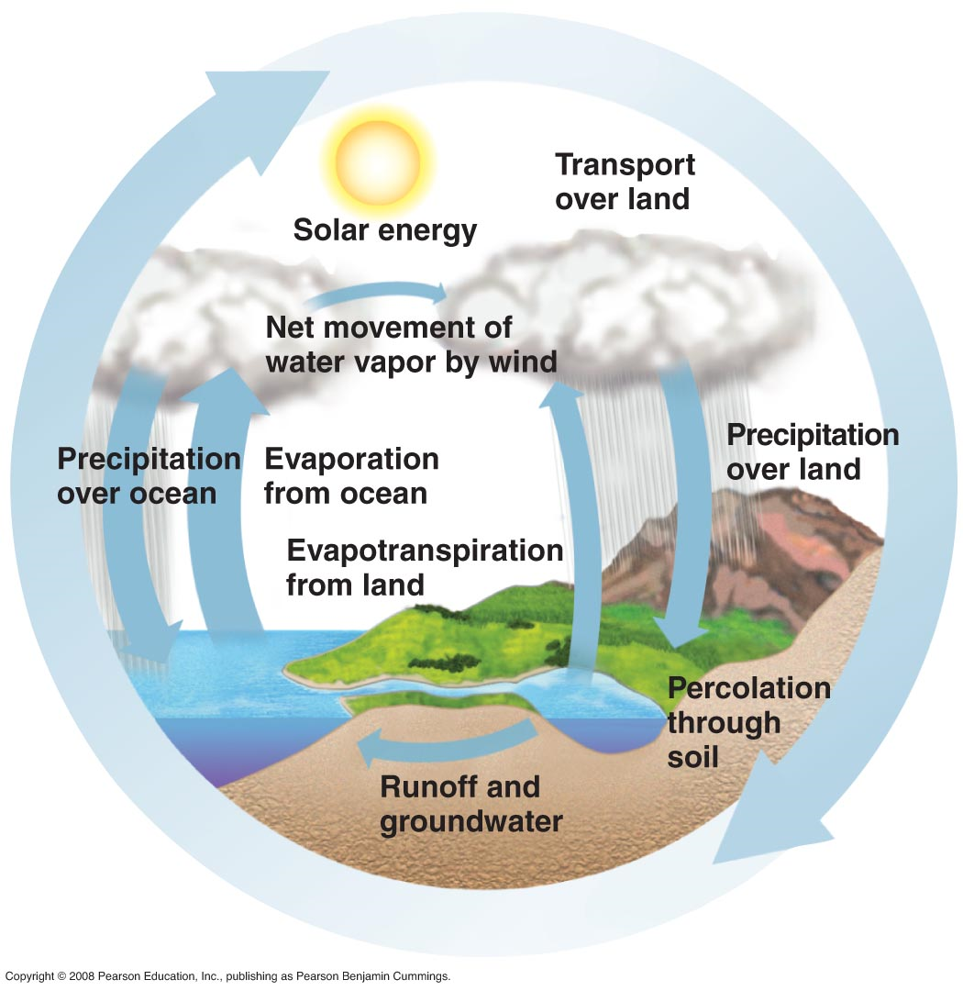
Chemical Cycling
Water Cycling

Slide 27
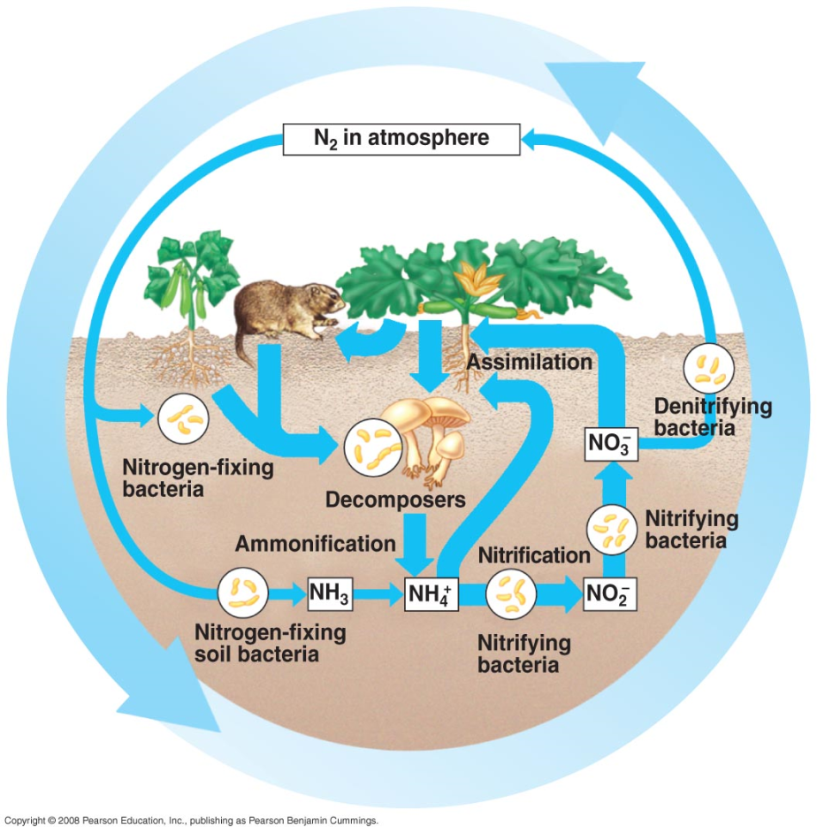
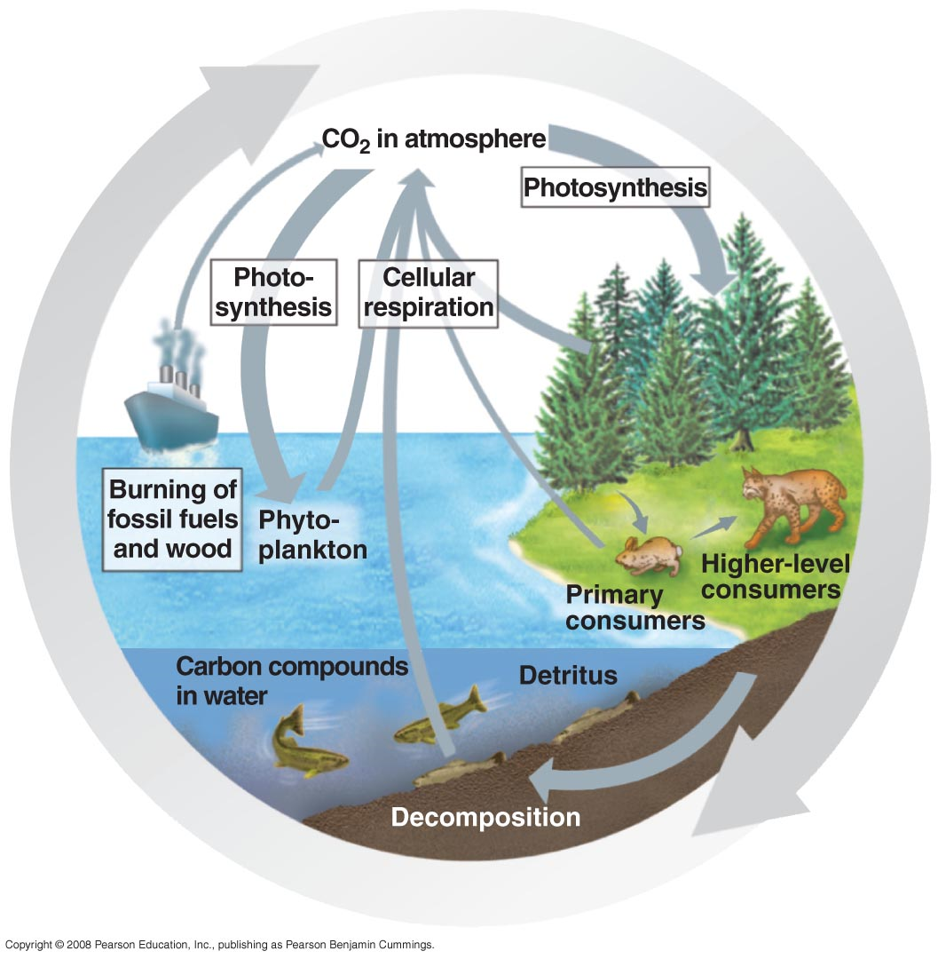
Nitrogen Cycle
Carbon Cycle

Slide 28
Ending Notes
All pictures were taken from flickr/Mr. Chinn’s Notes
Included in this study guide is most of the topics covered in the AP Biology test and SATII Biology test in our experiences
Do not forget to look at the animal behavior PowerPoint
Hope you enjoyed reading this and good luck on your test!

